Slide 1
Design - Data warehouse requirements, OLTP/OLAP, the star schema, Data Warehouse approaches, methodology

Slide 2
OLTP/OLAP – towards a DW

Slide 3
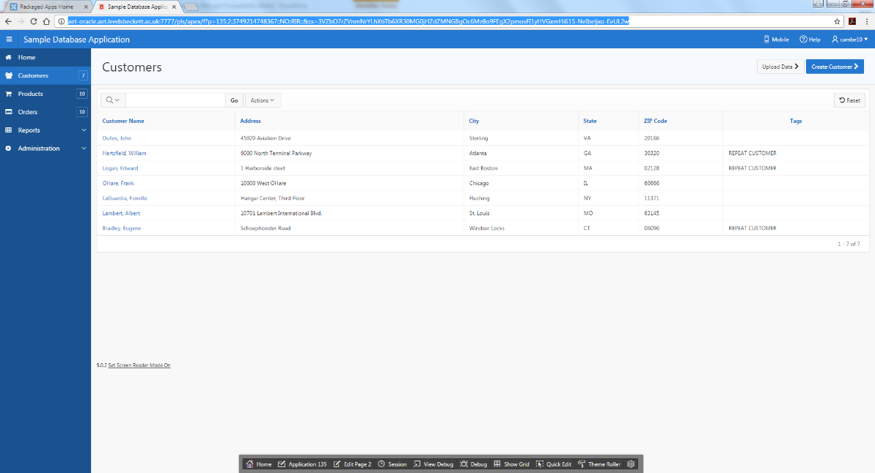
OLTP – Operational system
OLTP (on-line transaction processing)
  Major task of traditional relational DBMS
  Day-to-day operations: purchasing, inventory, banking, manufacturing, payroll, registration, accounting, etc.
  INSERT, UPDATE, DELETE
  Reports to help with day/week tasks
  Demo sample database

Slide 4
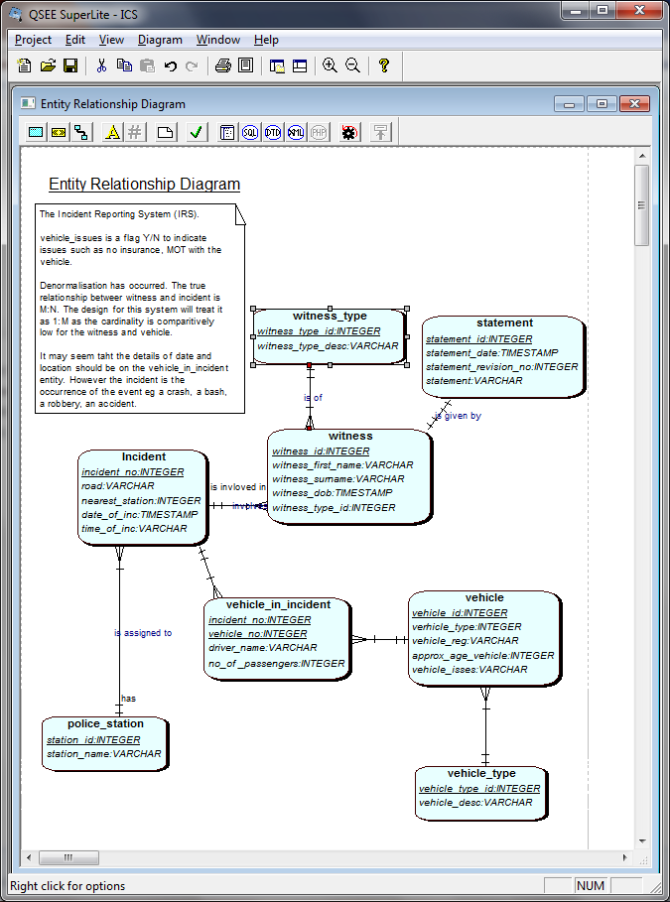
Notes:
Find out incidents today?
Incidents last year on the same day?
How many incidents person ??? Has been involved with?
How many incidents ever?

Slide 5
Lets take a promotion ☺
As a business owner/ director / strategist/ head of global economic in the UK / business consultant
Direct, understand, provide strategy for the Company

Slide 6
Companies use their data to
Answer questions
Evaluate processes, understand their market, analyse trends

Slide 7
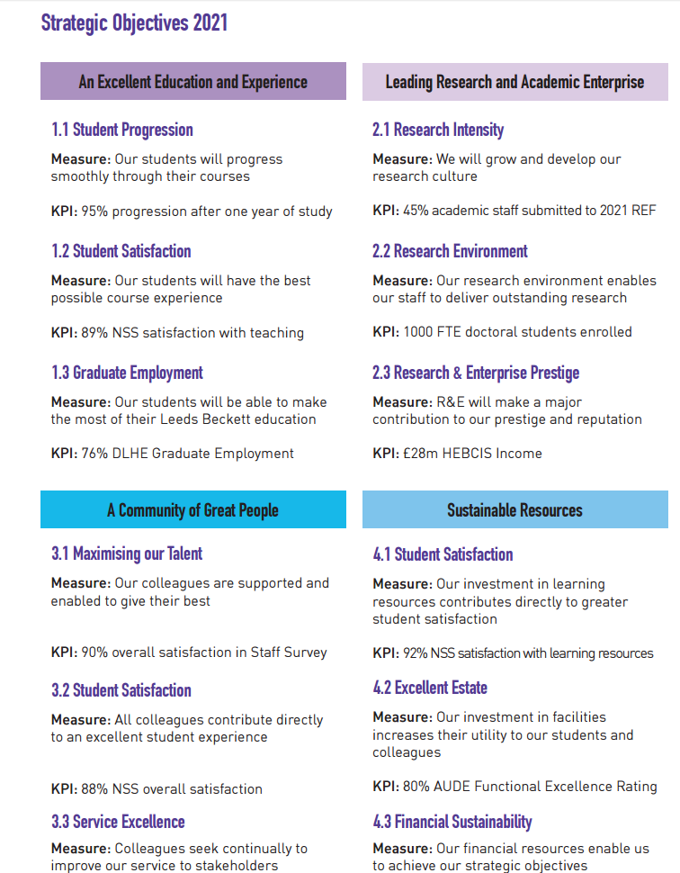

http://www.leedsbeckett.ac.uk/public-information/strategic-plan/

Slide 8
Decision support systems
Data base systems two types
  Transaction processing systems: OLTP
  Decision support systems: warehouses, OLAP, Mining
Historical data from OLTP systems form decision support systems
Goal: Learn from experiences in historical data
OLTP: many short, update intensive commands
Decision support: fewer, larger queries.

Slide 9
Data Warehouse, OLTP and OLAP
OLTP (on-line transaction processing)
  Major task of traditional relational DBMS
  Day-to-day operations: purchasing, inventory, banking, manufacturing, payroll, registration, accounting, etc.
OLAP (on-line analytical processing)
  Major task of data warehouse system
  Data analysis and decision making
Distinct features (OLTP vs. Data Warehouse):
  User and system orientation: customer vs. market
  Data contents: current, detailed vs. historical, consolidated
  Database design: ER + application vs. star schema + subject
  View: current, local vs. evolutionary, integrated
  Access patterns: update vs. read-only but complex queries

Slide 10
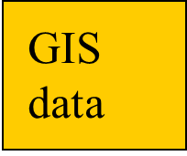
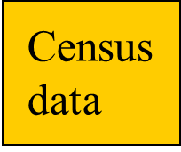
**
Data
Mining
Direct
Query
Reporting
tools
OLAP
Essbase
Intelligent Miner
SQL
Crystal reports
Merge
Clean
Summarize
Relational
DBMS+
Data warehouse
Detailed
transactional
data
ETL
Hong Kong branch
London branch
Beijing branch
Oracle
IMS
SAS
Operational data

Slide 11
“A data warehouse is a
subject-oriented,
integrated,
time-variant,
and nonvolatile collection of data in support of management’s decision-making process.”—W. H. Inmon

Slide 12
The Star Schema – a data model

Slide 13
Notes:
Find out incidents today?
Incidents last year on the same day?
How many incidents person ??? Has been involved with?
How many incidents ever?

Slide 14
Data model options - Relational format
Needs to be restructured
For each report?
Could just have a massive spreadsheet …
Or a star schema
Or connections to all the other db (oltp) systems
Yuk

Slide 15
Dimensional Modelling
ER Techniques adopted
Fact Table
  Factual or quantitative data
  Generated by events
  Compound primary key
Dimension Tables
  Simple, non-composite Primary Key
  Descriptive
Notes:
Fact table will have attributes such as, quantity sold, orders made, products produced, appointments made.
The compound key is made up of the Foreign keys being the primary keys of the …
Dimension tables
Hold descriptive data about the subject.

Slide 16
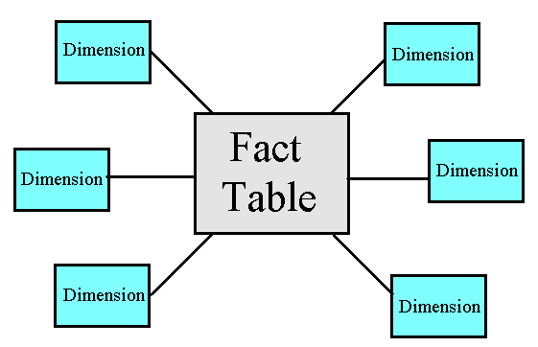
Star schema
A set of de-normalised DIMENSION tables giving DESCRIPTIONS, pointed at by:
One central FACT table containing numeric measures

Slide 17
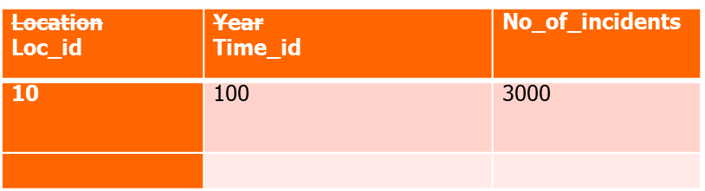
Star schema
location
Time_period
Loc_id | Loc_desc
10 | M62
11 | M1
time_id | time_desc
100 | 2002
110 | 2003
Fact_incidents

Slide 18
Benefits of the Dimensional Model
Simple structures for users to understand
Effective data extract achieved through the use of appropriate dimension tables
Aggregated data readily to hand
Drilling possible, as far as data allows
Well tried and understood tools available, both for extracting data and presentation

Slide 19
Problems of the Dimensional Model
Drill up/down is slow as requires access to other stars
Drill across and through not so easily understood by users.
Can be problems of scalability
Main point: Needs specific tools (eg better than Access!) if to run efficiently. Eg new forms of indexing of table rows.

Slide 20
Data Warehouse Approaches

Slide 21
OLTP/OLAP (decision support) Why Separate the Data Warehouse?
High performance for both systems
  DBMS— tuned for OLTP: access methods, indexing, concurrency control, recovery
  Warehouse—tuned for OLAP: complex OLAP queries, multidimensional view, consolidation.
Different functions and different data:
  missing data: Decision support requires historical data which operational DBs do not typically maintain
  data consolidation: DS requires consolidation (aggregation, summarization) of data from heterogeneous sources
  data quality: different sources typically use inconsistent data representations, codes and formats which have to be reconciled

Slide 22
Chapter 2 of Chris Adamson’s book: Star Schema - The complete reference
(in library etc)

Slide 23
Data Warehouse Approaches
Inmon Corporate Information Factory (EDW)
Kimball dimension modelling (EDW)
  Bus Architecture
Stand alone data marts (not EDW still common)
EDW – Enterprise DW

Slide 24
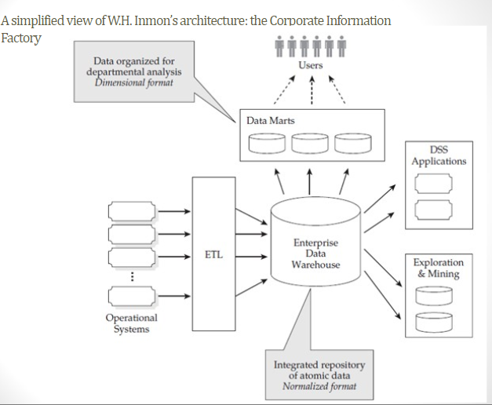

Slide 25
Inmon’s corporate information factory
Hub and spoke
There is still a role for star schema
ETL is from operational to EDW
The EDW is not directly queried
Atomic data in the EDW

Slide 26
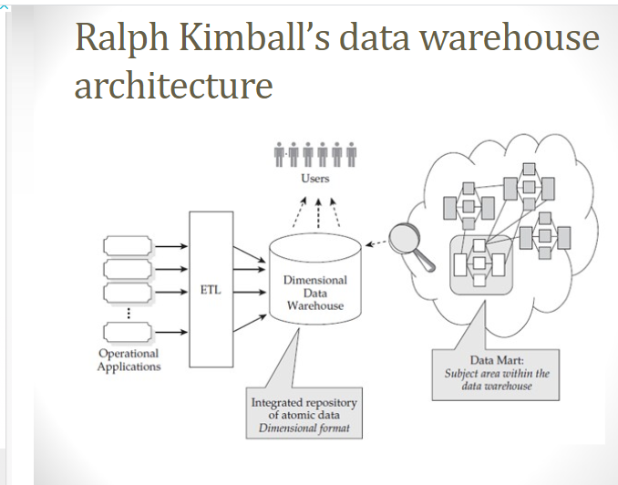

Slide 27
Kimball’s dimensional DW
Or “bus architecture” (a collection of DMs)
Dimension model is used for the DW and Data Marts (DM)
ETL is used more generically
Atomic data in the DW (possibly) not in the DM (higher level of granularity)

Slide 28
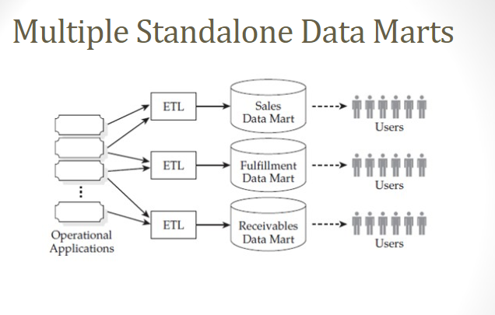

Slide 29
Stand Alone Data Mart
Is neither of the others
Developed out of necessity, uses the techniques
ETL / Dimension / bus architecture
Data granularity?

Slide 30
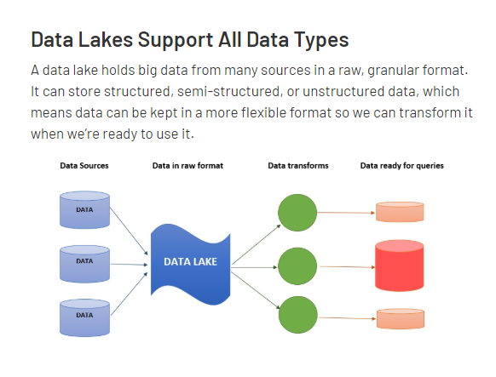
Data Lake?
Notes:
https://databricks.com/glossary/data-lake
Hadoop

Slide 31
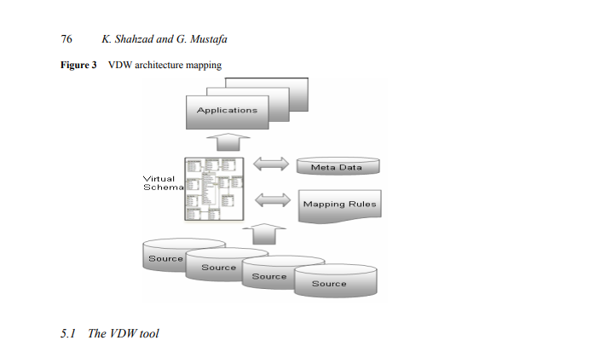

Slide 32
Consider which we are using on this module?
Reflect on the term DW ‘approach’
Note the nature of the business, department, strategy
Consider the role of data
The turnaround for projects
We will discuss in class and
Remember ….

Slide 33
**
Data
Mining
Direct
Query
Reporting
tools
OLAP
Essbase
Intelligent Miner
SQL
Crystal reports
Merge
Clean
Summarize
Relational
DBMS+
Data warehouse
Detailed
transactional
data
ETL
Hong Kong branch
London branch
Beijing branch
Oracle
IMS
SAS
Operational data

Slide 34
“A data warehouse is a
subject-oriented,
integrated,
time-variant,
and nonvolatile collection of data in support of management’s decision-making process.”—W. H. Inmon

Slide 35
Methodologies and documentation

Slide 36
A project Approach
Software Development Lifecycle
Data Life Cycle
Agile Approach
CRISP-DM
Team Data Science Project (TSDP)
PPDAC (Problem, Plan, Data, Analysis, Conclusion)
Notes:
https://www.insightsforprofessionals.com/it/analytics/data-warehouse-vs-data-lake
BI and ETL: Running in a Data Lake without a Rigid ETL Process
With the advent of data lakes and technologies like Hadoop, many organizations are moving from a strict ETL process, in which data is prepared and loaded to a data warehouse, to a looser and more flexible process called Extract, Load, Transform (ELT).
Today ELT is mainly used in data lakes, which store masses of unstructured information, and technologies like Hadoop. Data is dumped to the data lake without much preparation or structure. Then, analysts identify relevant data, extract it from the data lake, transform it to suit their analysis, and explore them using BI tools.
Does the Data Lake Replace the Data Warehouse?
ELT is a workflow that enables BI analysis while sidestepping the data warehouse. But those same organizations that use Hadoop or similar tools in an ELT paradigm, still have a data warehouse. They use it for critical business analysis on their central business metrics—finance, CRM, ERP, and so on.
Data warehouses are still needed for the same five reasons listed above. Raw data must be prepared and transformed to enable analysis on the most critical, structured business data. If management needs to see a weekly revenue dashboard, or an in-depth analysis on revenue across all business units, data needs to be organized and validated; it can’t be pieced together from a data lake.
Can such a structured analysis happen without a rigid ETL process? Or in other words, are ELT strategies relevant inside the data warehouse?

